Slide 1
Avoiding being a script kiddie
by ViviTurtle

Slide 2
Why
To think like a “hacker”
The purpose is so that when we do talk about “Infosec Stuff” at future talks, you’ll be able to understand at least a little
Ethics:
All members are required to attend an ethics talk this year.
Club not accountable for any malicious activities you engage in.
To protect yourself against hackers, you have to think like one.

Slide 3
Terminology

Slide 4
Malware

Slide 5
Umbrella term for malicious software

Slide 6
Virus

Slide 7
Malicious code that must be executed by user

Slide 8
Worm

Slide 9
Malicious code that is propagated through a network

Slide 10
DDOS

Slide 11
Distributed Denial of Service

Slide 12
Uses a list of servers to attack

Slide 13
Script kiddie

Slide 14
Kid who doesn’t know how things work and only runs premade scripts

Slide 15
Doxxing

Slide 16
Getting people’s personal information like ssn or address

Slide 17
Rootkit

Slide 18
Powerful malware that conceals its presence

Slide 19
Web Basics

Slide 20

HTTP
Hypertext Transfer Protocol
Main network protocol used on the world wide web
https://upload.wikimedia.org/wikipedia/commons/7/75/Internet1.jpg

Slide 21

HTTPS
HTTP + Secure Uses SSL/TLS
Encrypts web traffic to mitigate MITM attacks
https://upload.wikimedia.org/wikipedia/commons/d/da/Internet2.jpg

Slide 22
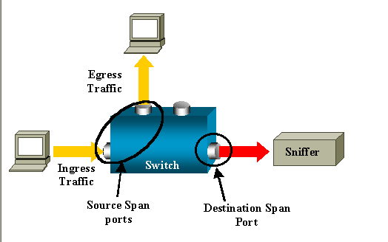
Sniffing
Grabbing info that is otherwise supposed to be private to user
https://itdaddy.files.wordpress.com/2008/05/sniff.png

Slide 23

Encryption, Hashing, and Encoding
http://www.ip-watch.org/weblog/wp-content/uploads/2015/06/encryption-image.png

Slide 24
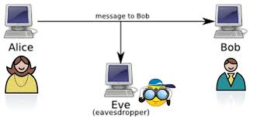
Encryption
Making it so any data cannot be read during its transfer Can be decrypted because end user knows how
Secure Connections
http://osiriderce.altervista.org/wp-content/uploads/2014/07/aliceBob.jpg

Slide 25
Hashing
“One way encryption”
Cannot be decrypted
MD5, SHA256, MD1….
Usages: Data Validation (Compare hashes) Storing Personal Data (Like passwords)

Slide 26
Encoding
“Same Data, different look”
“Can send data in readable format”

Slide 27
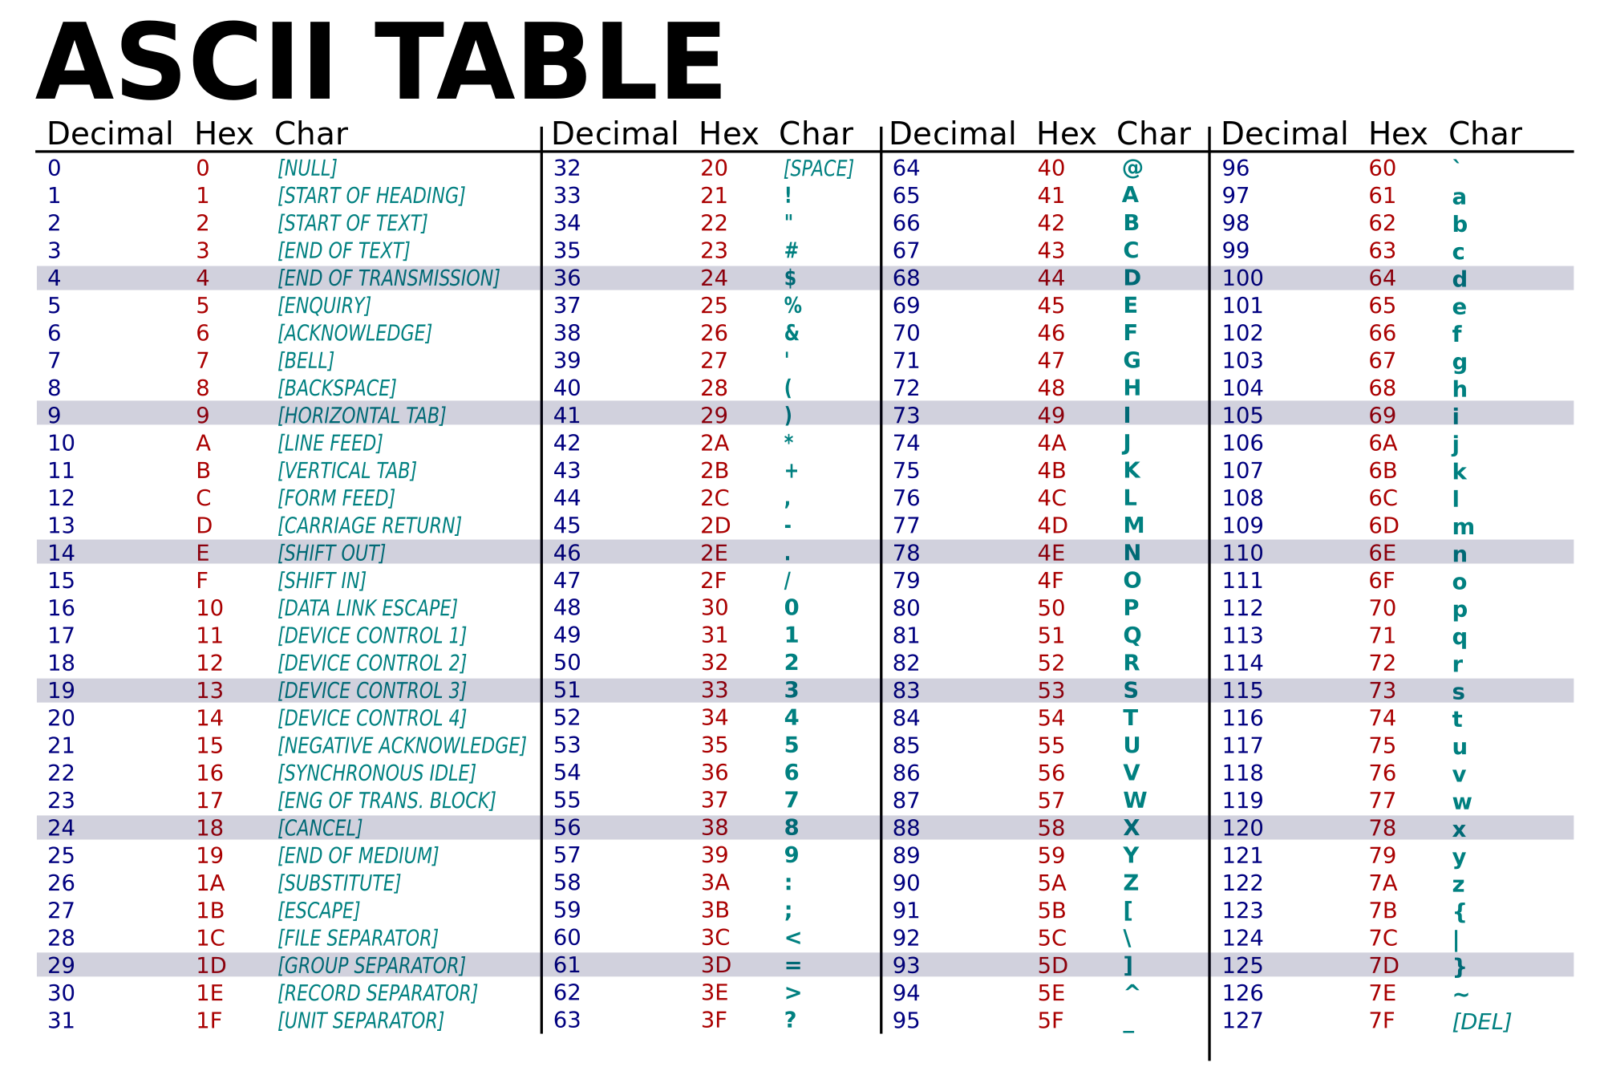
Common Encoding Character Sets
Base64 {A-Z, a-z, 0-9, (+/) }
Hexadecimal {0-9, A-F}
ASCII {see table}
Binary {0,1}
https://upload.wikimedia.org/wikipedia/commons/thumb/1/1b/ASCII-Table-wide.svg/2000px-ASCII-Table-wide.svg.png

Slide 28
Networks and VM’s

Slide 29

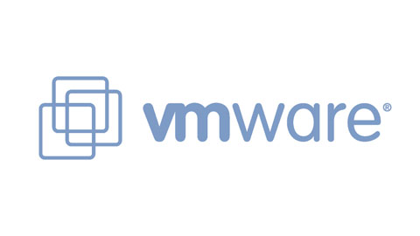
Virtual Machines
Lets you emulate a network and/or Operating System Used to be physical, now its virtual
http://www.oracle.com/ocom/groups/public/@otn/documents/digitalasset/176619.png
https://www.mirantis.com/wp-content/uploads/2013/02/vmware_view_pilot-5132020.jpg

Slide 30
Operating Systems
Software that manages hardware (9/10 times computer repairs just reformat computer)
Examples are Linux, Windows, and OS X If you have never reformatted your own computer try install an OS on a VM. You should know how to at the very least set up your own computer if it breaks, or you are just wiping everything and starting fresh (Show Example)

Slide 31
Intro to Linux

Slide 32

Why Linux
Many tools are in command line (all tools in one place):
msf, md5sum, bash, python, hydra, medusa, sqlmap, …
Many servers are only command line to optimize space and usages (GUI takes up speed)
Open source tools commonly on open source platform
Many distributions.

Slide 33
Linux commands
ls: list files of current directory
cd: change directory
rm: remove file
mv: move files and/or rename
clear: clear terminal
text editors: vi, vim, leadpad, emacs, nano
.. previous directory
/ root directory (what is a directory?) learn to man
Tools:
ssh, netcat, ftp

Slide 34
InfoSec Branches

Slide 35
Cryptography
Secure Encrypting/Decrypting Data
Algorithms
Breaking insecure cryptography
http://www.ip-watch.org/weblog/wp-content/uploads/2015/06/encryption-image.png

Slide 36

Web Application Penetration Testing
Hacking databases
Hacking website users
Breaking the website
http://www.aslitsecurity.com/images/web-penetration-testing.jpg

Slide 37
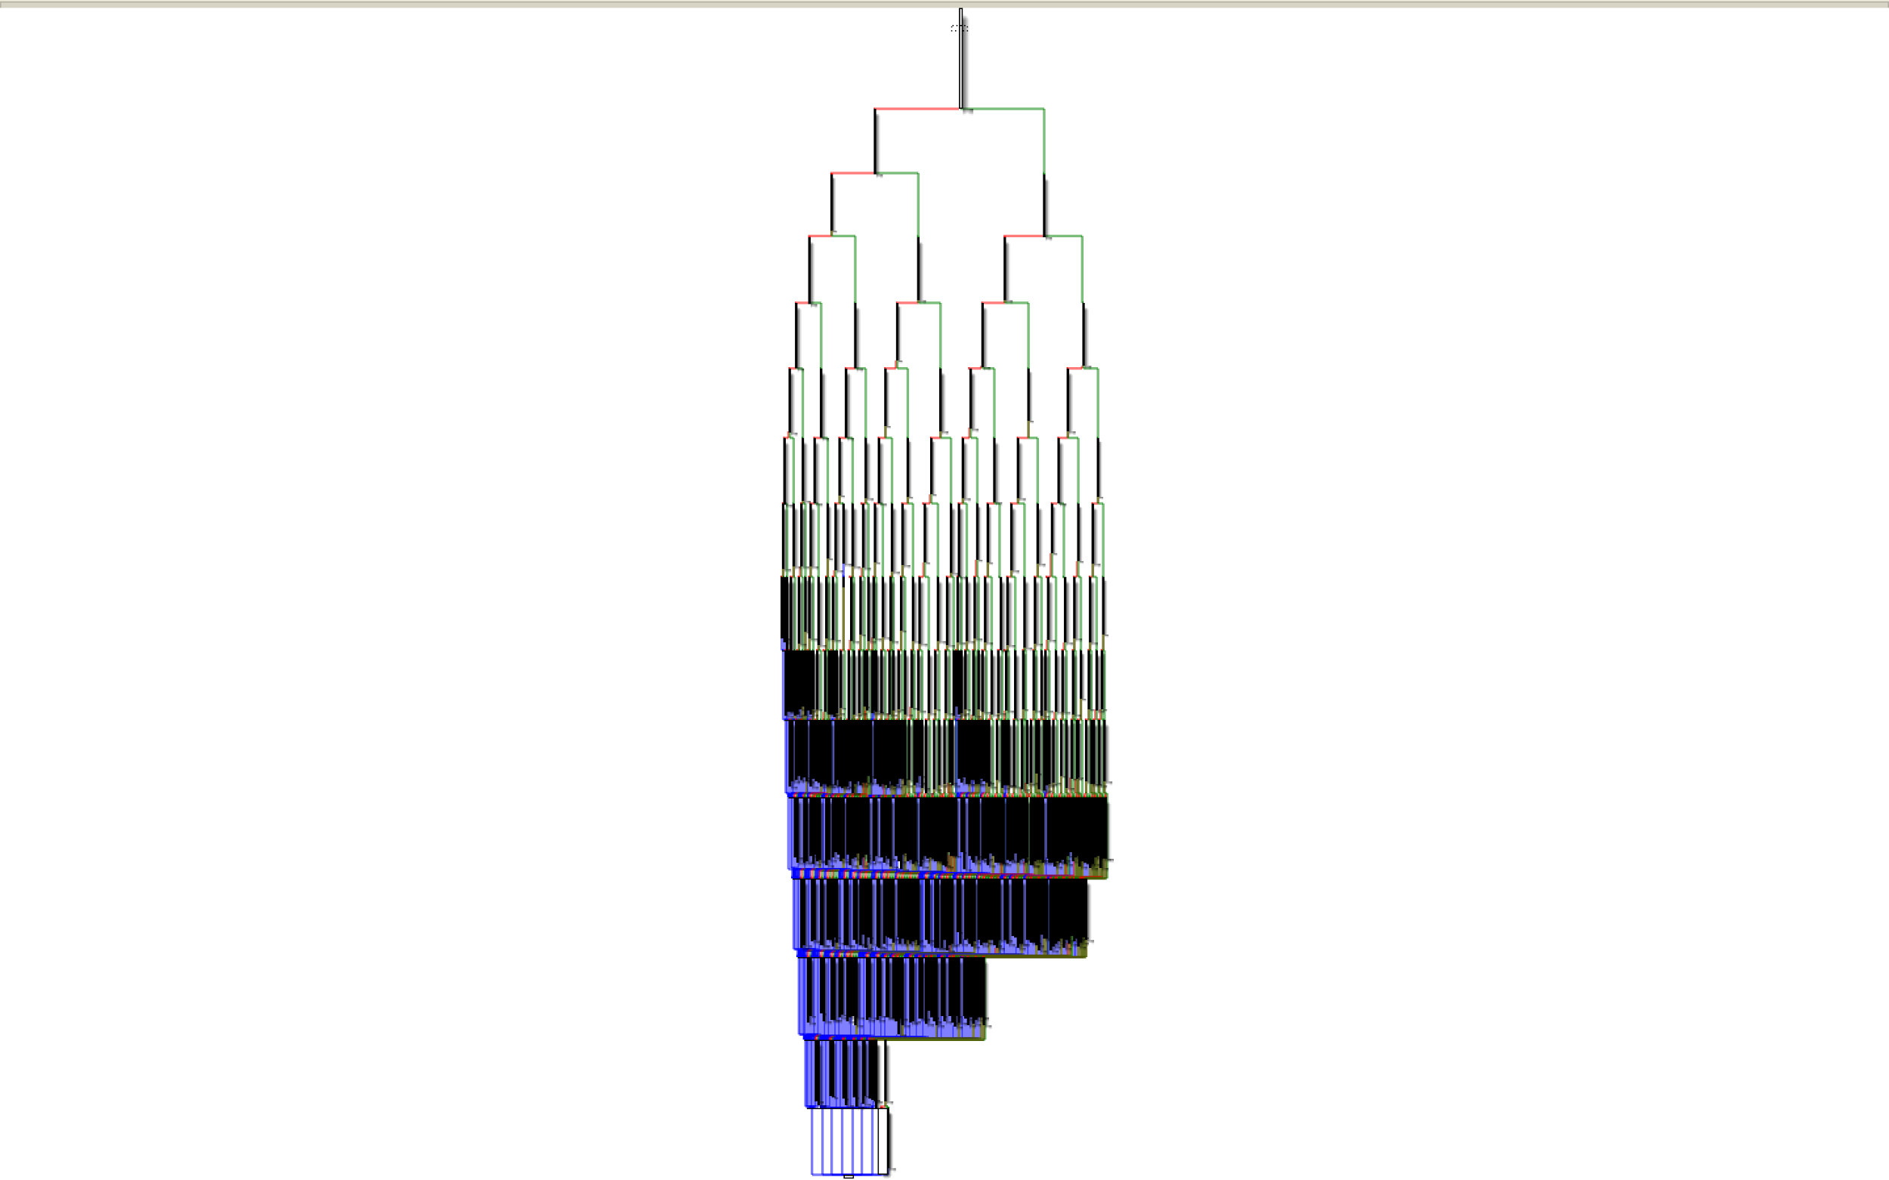
Reverse Engineering
“Going backwards through the development cycle”
Used a lot for malware analysis, binary analysis and vulnerability discovery
Deterred by obfuscation techniques:
anti-disassembly
anti-debugging
packers

Slide 38
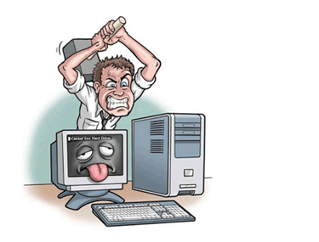
Exploitation
Take advantage of flawed code to perform unintended action
memory corruption vulnerabilities
race conditions
implementation errors
input validation errors
http://www.expressunlimitedpcmac.com/images/computer_hammer.gif

Slide 39

Social Engineering
Get people to do what you want
Hack people
#1 vulnerability in InfoSec is people
Phishing
Lying to people
https://www.cybertec-security.com/wp-content/uploads/2014/11/social-engineering.png

Slide 40
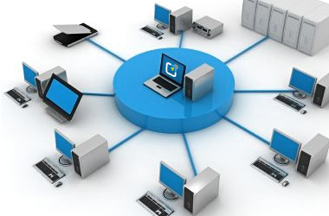
System/Network Administration
Managing the Systems and Networks
Secure practices
Stopping Live Attacks
http://www.it-doctor.co.th/images/computer_network_administration.jpg

Slide 41
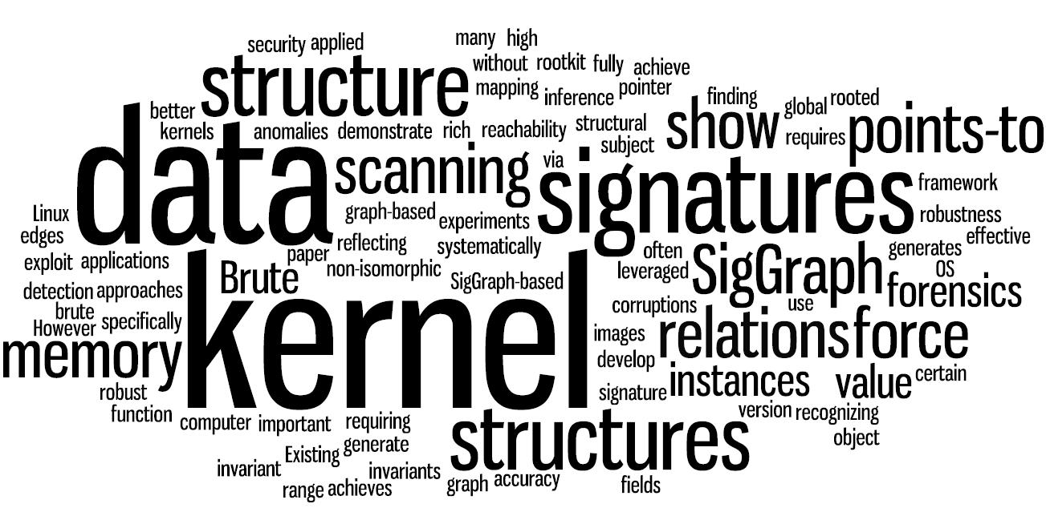
Memory Forensics
Looking at Memory Artifacts
Reverse Engineering for Whole Systems
Who - What- When- How- Why
https://www.utdallas.edu/~zxl111930/img/ndss11.jpg

Slide 42
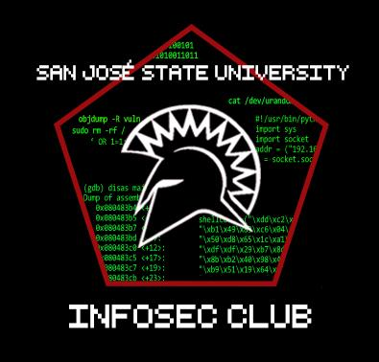
We’ll stop there :)
Questions???
Discuss
Need help?
Mentor Program
Survey
https://docs.google.com/forms/d/1N5S1heDN-onnO_hTla74NPWpYGenOyGd-Sgmz-Q9jBU/viewform?usp=send_form

